Slide 1
Nile iVision Project

Slide 2
Customer Sentiment Analysis
From the graph we can see that, most of the customer sentiments after availing the customer service facility has been found to be negative.
However, neutral sentiments are found to be closely following the negative sentiment parameter.
Very negative sentiment rules over positive sentiments significantly. Therefore, we can say that the customer service provided by Nile can be overall branded as being unsatisfactory from the customers’ point of view.
I would suggest that, focus be put on conversion of negative sentiments to neutral, as an immediate plan of action, instead of focusing on garnering increasingly positive reviews. Once the neutral sentiment count exceeds negative, from there on, work can be done towards addition of positive review count.

Slide 3
Response time Analysis
SLA (Service level agreement) conditions have been satisfied and have thus been found to be on the higher side.
However, from this and the previous customer sentiment graph, we can infer that SLA count is by no means a yardstick for analysis of customer sentiment.
We can therefore conclude that, for this particular company and the type of target customers, service above SLA count needs to be increased, in order to shift the pattern of customer sensitivity from negative to neutral.

Slide 4
Reason Analysis
In this analysis of the variety of reasons for which customers used the service of Nile customer help, we see that Service Outage ranks the highest, when it comes to priority of concern. Followed by a small amount divided between questions related to ‘payments’ and ‘Billing questions.’
Trends in this data is very evident, since people normally tend to take help of services, only when there is a complete stoppage to any sort of functioning with the respective device or application in question.

Slide 5
Channel percentage Analysis
This analysis shows the percentage of varying channels used as customer assistance service
Call center ranked the highest. Since service outage was the most prominent reason for which people reached out for assistance, therefore, a problem of larger importance required a solution process of the highest clarity.

Slide 6
CSAT score Analysis
The CSAT score can be seen to increase with time. However, we cannot predict with certainty whether it is a correct trend.
We can analyse that, since October- December is the festive season and spending rockets, therefore problems with payments are common. As a result, the number of hits for assistance required increases, which further boosts the CSAT number, which can be owed to the sheer number of increase in the number of calls.

Slide 7
Analysis of call duration
Chicago has been found to have recorded the longest duration of calls in its call centre and also the longest duration in email conversations.
This can be owed to the large cosmopolitan diaspora in Chicago, where statistically, people prefer the conventional mode when it comes to problem solving, i.e., talking in person, or writing an email.
Whereas, Los Angeles, would mostly belong to a slightly upper tier of people, statistically, than the rest of the cities in question. Therefore, more tech savvy people would initially incline towards solving the problem through digital communication, without having to make calls in person, first.

Slide 8
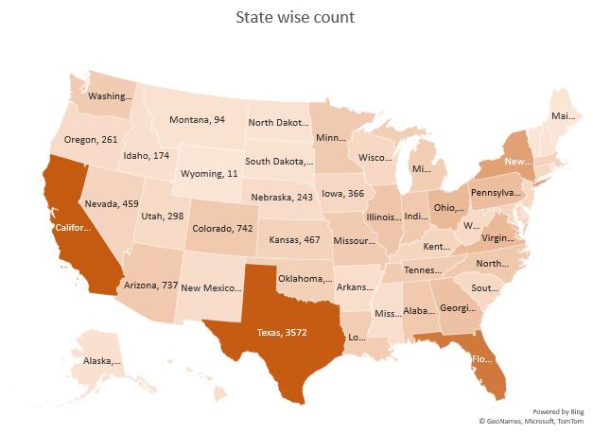
State wise count analysis
The cities with the largest International population were found to have been registered with the largest number of calls/hits.
Texas ranked the highest owing to its sheer size, compounded with its increasingly multinational landscape.
Colorado, Utah being student cities, faired with very low number of availing of customer help services.
However, the size of the state and population remains to be the primary determinant, when performing state wise count analysis.

Slide 9
THE END

